Slide 1

What is the el.Bilietas Šiauliai App?
The el.Bilietas Šiauliai app is the official public transportation application for the city of Šiauliai, Lithuania. It helps users navigate the city’s bus network and manage public transport tickets.

Slide 2
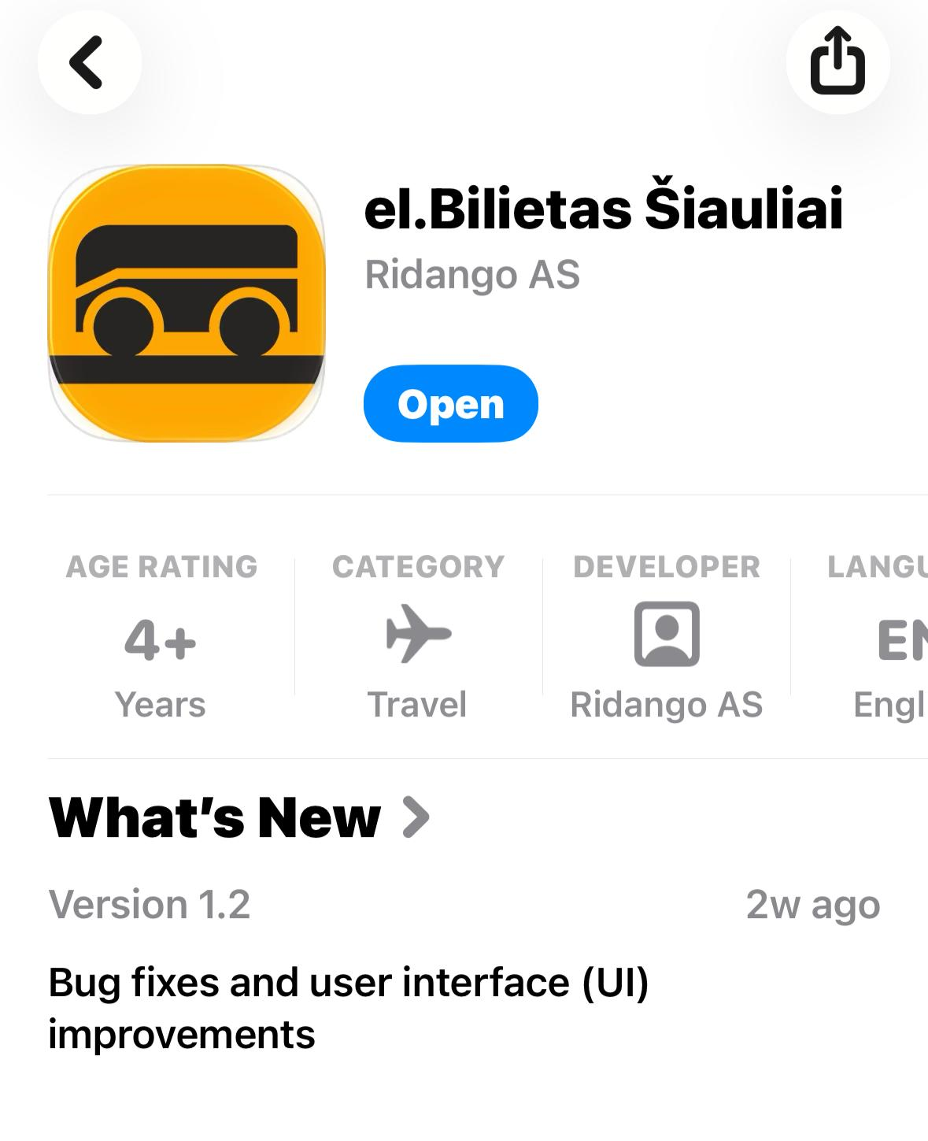
With this app, you can:
* Plan your journey.
* View bus routes and schedules.
* Find nearby bus stops.
* Track public transportation information.
* Purchase and manage electronic tickets
1. Downloading the App
Download and install the el.Bilietas Šiauliai app from the App Store or Google Play Store.
After installation, open the app and allow location access for a better experience.

Slide 3
2. Main Features
Journey Planner
The Journey Planner helps you find the best route between two locations.
How to use it:
1. Open the app and select “Plan a Journey.”
2. Enter your current location in the “From” field.
3. Enter your destination in the “To” field.
4. The app will display:
* Recommended bus routes,
* Transfer points (if necessary),
* Estimated travel time.

Slide 4
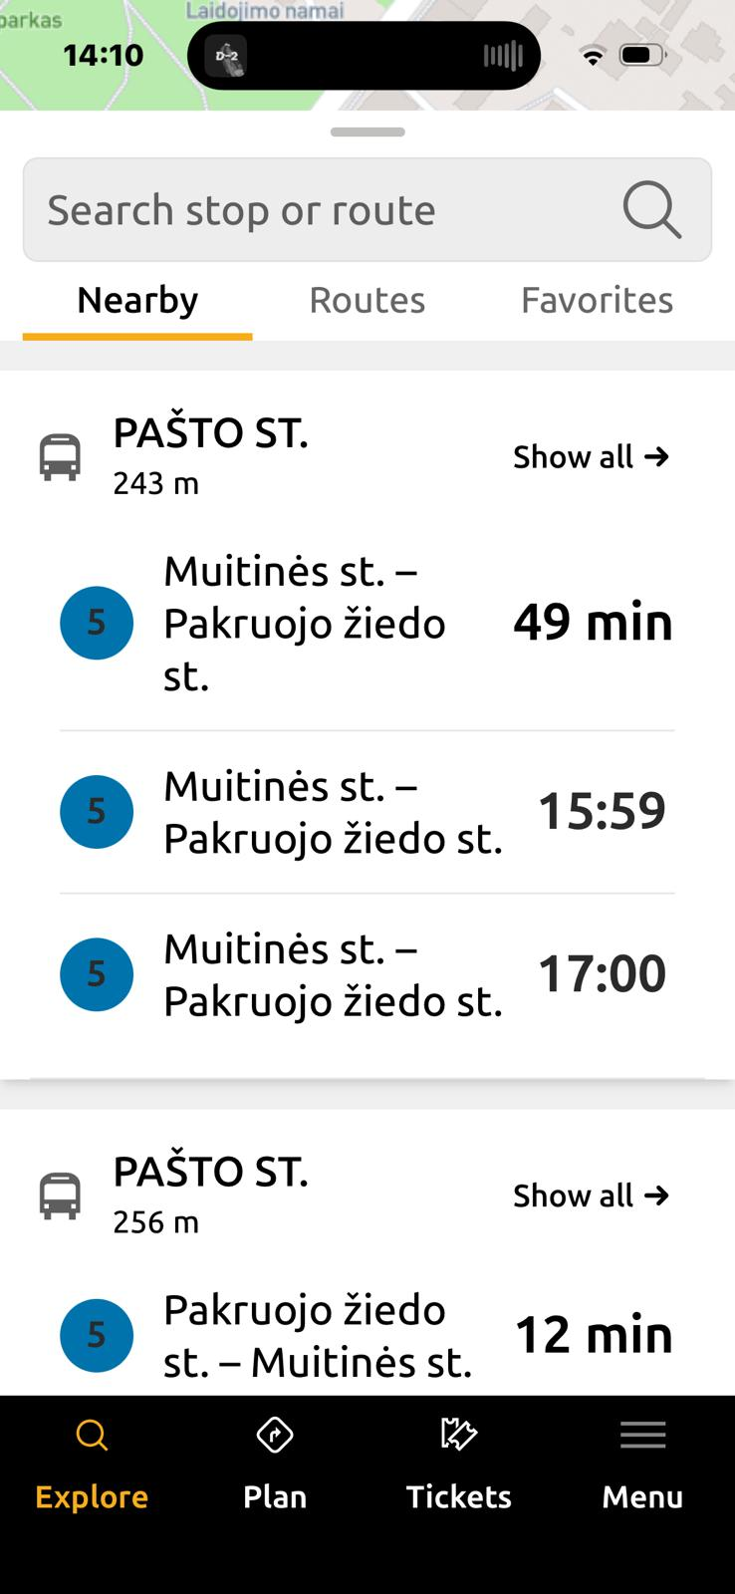
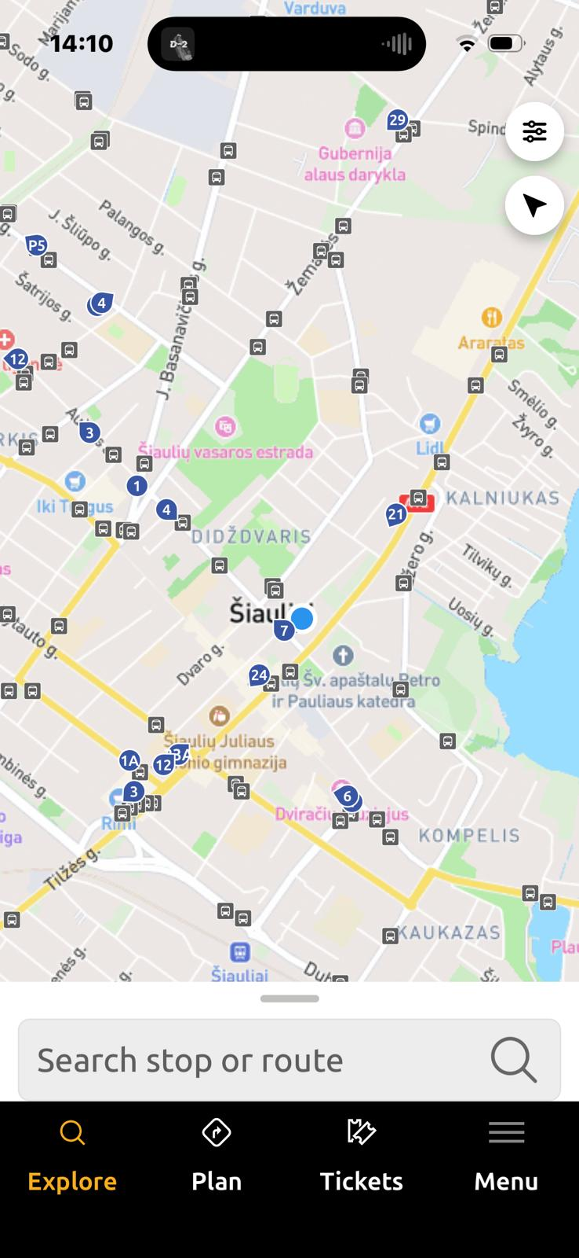
Map
The Map section allows you to:
* View nearby bus stops,
* Explore bus routes,
* Check your location in relation to public transportation services.
Timetables
In this section, you can:
* Search for a specific bus stop,
* View bus arrival times,
* Check daily schedules for different routes.

Slide 5
Tickets
The Tickets section allows users to:
* Purchase electronic tickets,
* View active tickets,
* Manage ticket validity and travel history.

Slide 6

Planning a Trip
Imagine you want to travel from your university to the city center.
1. Open the Journey Planner.
2. Enter your university as the starting point.
3. Enter the city center as your destination.
4. The app will suggest the most suitable route and indicate which bus to take.
5. Follow the instructions and board the recommended bus.

Slide 7

Tips for Erasmus and International Students
✅ Use the app together with Google Maps during your first days in Šiauliai.
✅ Learn the Lithuanian names of common destinations and bus stops.
✅ Always check the bus route number before boarding.
✅ Make sure you have an internet connection when using the app.
✅ Save screenshots of your route if you are unfamiliar with the area.
This Photo by Unknown Author is licensed under CC BY

